Slide 1
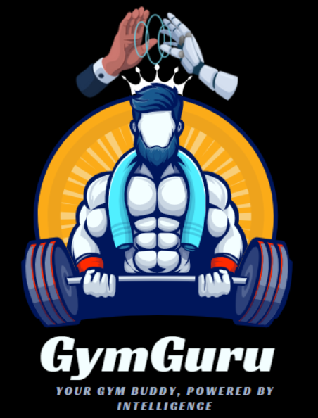
AI-DRIVEN FITNESS AND NUTRITION RECOMMENDER SYSTEM
A project supporting personalized recommendations for health and wellness.

Slide 2
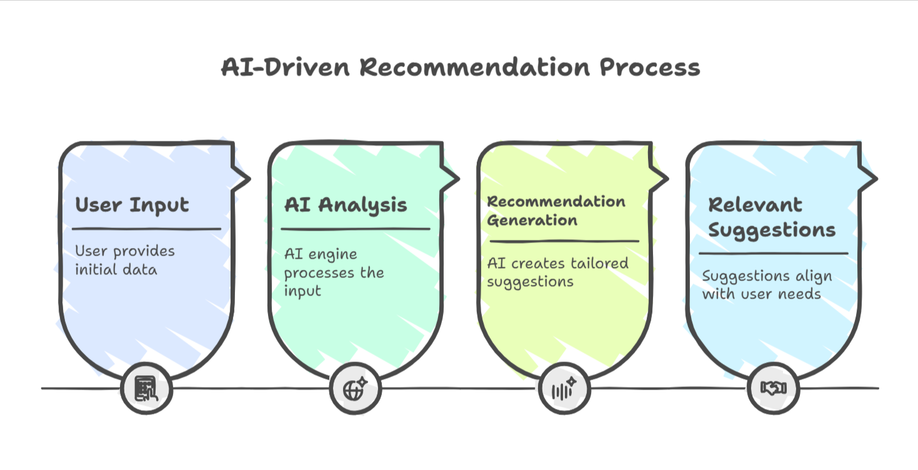
Introduction
GymGuru is a web-based AI-powered fitness and nutrition platform that helps users track and manage their health goals. From personalized meal and workout plans to motivational tools, GymGuru is your virtual fitness partner.

Slide 3
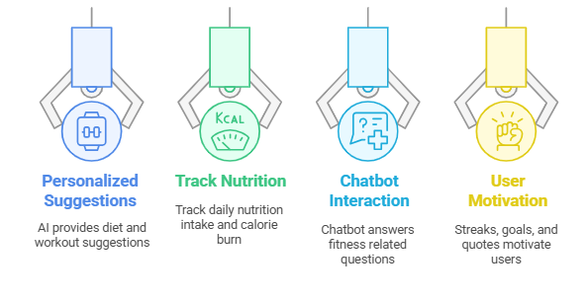
Project Objectives

Slide 4

Issue with generic plans
Many fitness platforms lack truly personalized recommendations and integration of both workout and nutrition tracking. GymGuru solves this by combining AI, ML, and web tech to offer holistic fitness support.

Slide 5
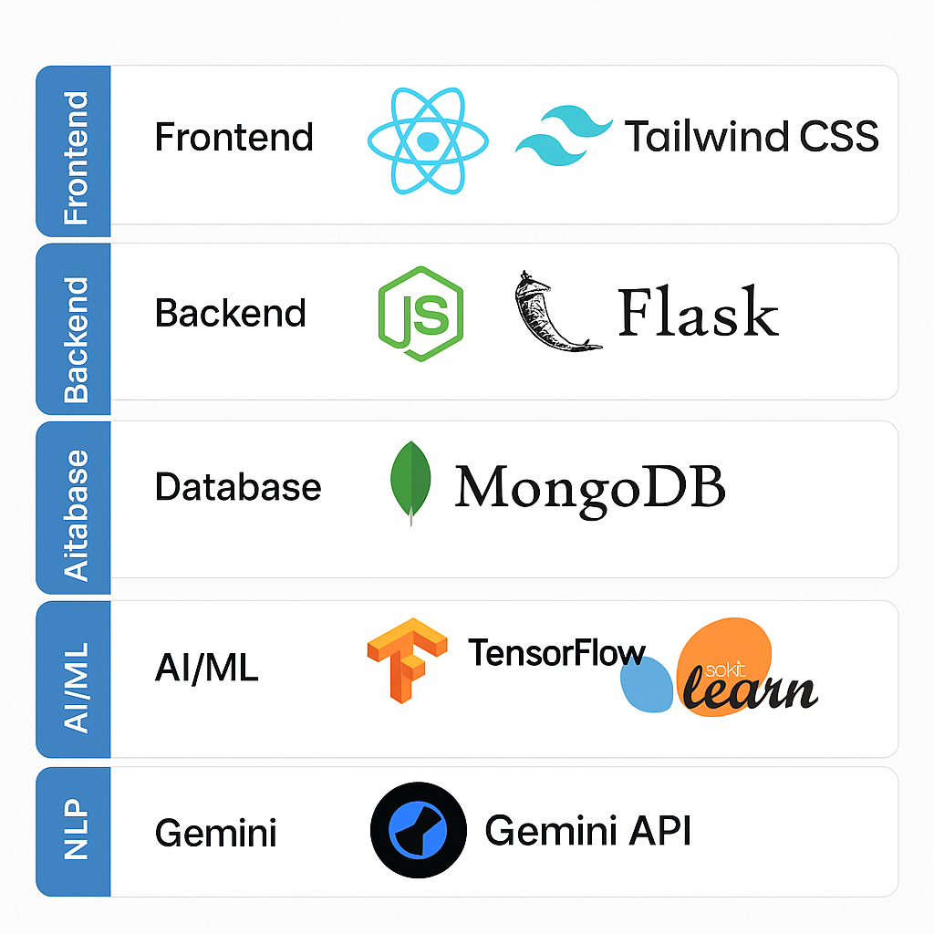
Tech Stack Utilized for the project

Slide 6
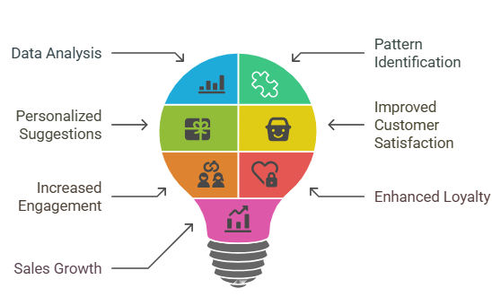
AI advantages in recommendations
AI can analyze vast amounts of user data, preferences, and performance metrics to deliver tailored recommendations that are more effective than generic plans.

Slide 7
Key System Features

Slide 8
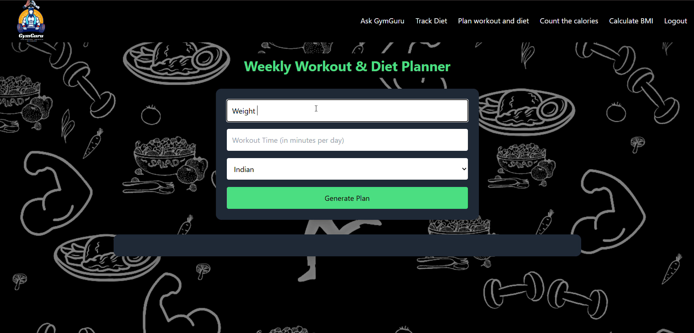
Personalized Exercise & meal Recommender

Slide 9
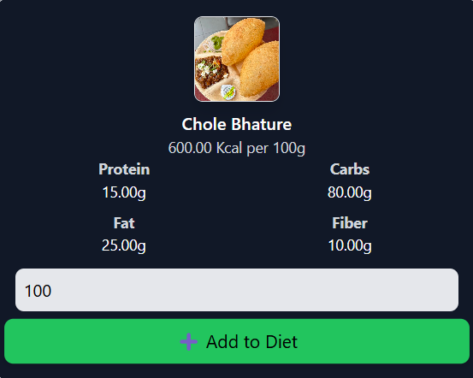
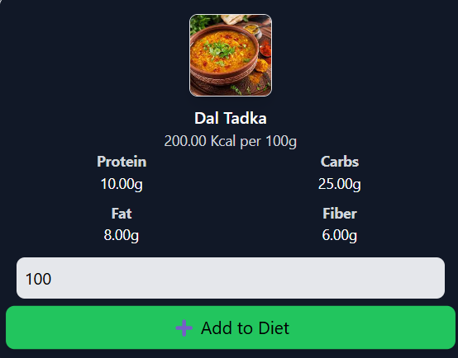
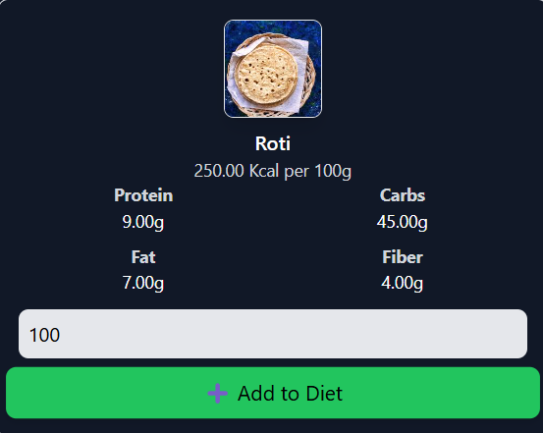
Nutrition tracker: Shows calories,protein,fiber,carbs

Slide 10
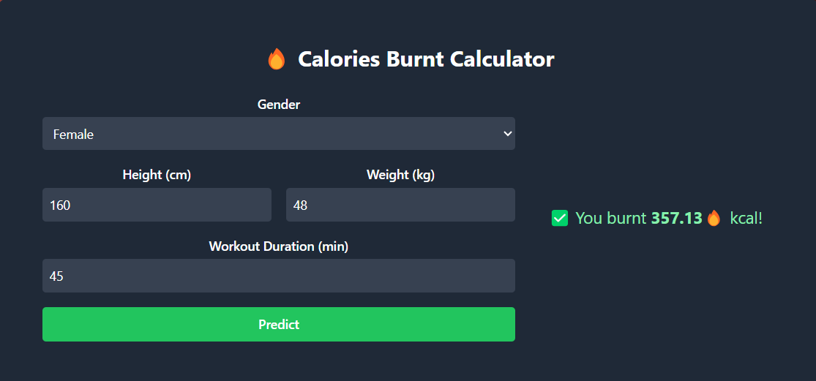
Calorie burn prediction model HIGH DEGREE POLYNOMIAL LINEAR REGRESSION

Slide 11
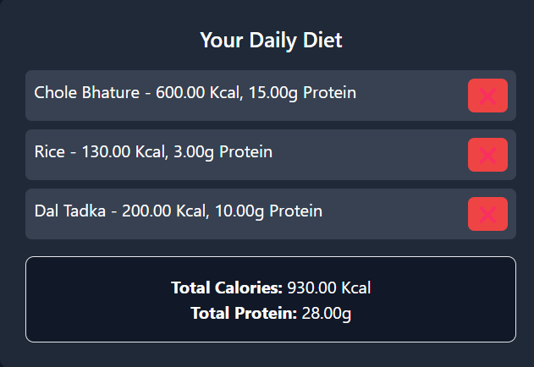
ADD TO DIET & COMPUTE TOTAL INTAKE

Slide 12
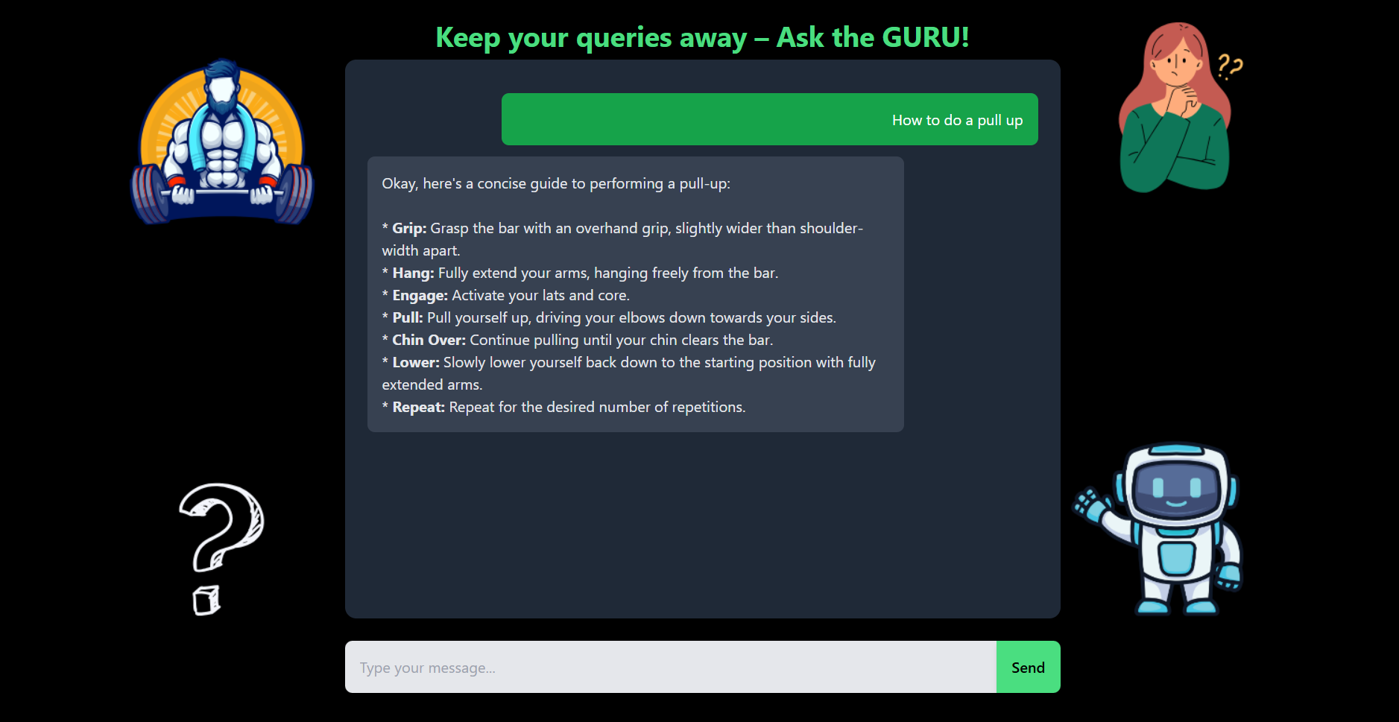
Fitness guru ai chatbot

Slide 13

Water intake tracker, Streak Counter and Motivational quotes

Slide 14
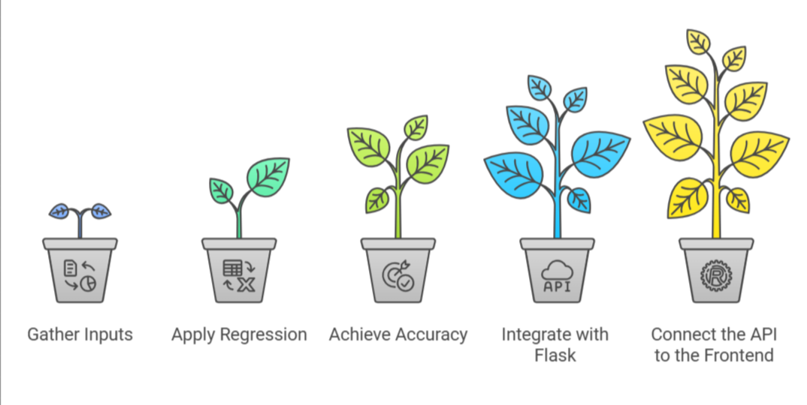
Calorie Burn Predictor (ML Model)

Slide 15
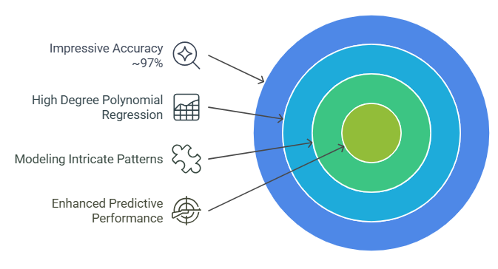

Slide 16
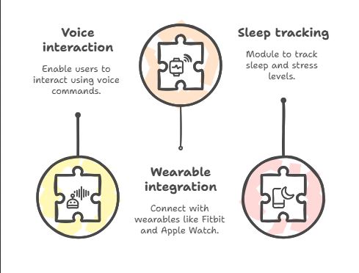
FUTURE SCOPES

Slide 17
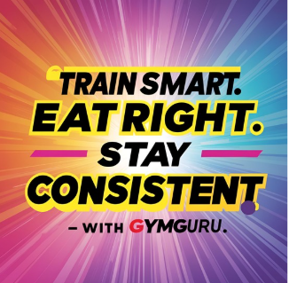
CONCLUSION
GymGuru combines AI, ML, and modern web technologies to offer a robust, user-centric fitness and nutrition platform. It promotes healthy habits, offers real-time tracking, and creates a personalized experience for each user.

Slide 18
Thankyou!!!!
Submitted By :
Palak Rana(A501132522012)
Vivek Yadav(A501132522010)
MINOR PROJECT -GYMGURU
B.Tech(AI&ML)
Sem – VI

